Slide 1

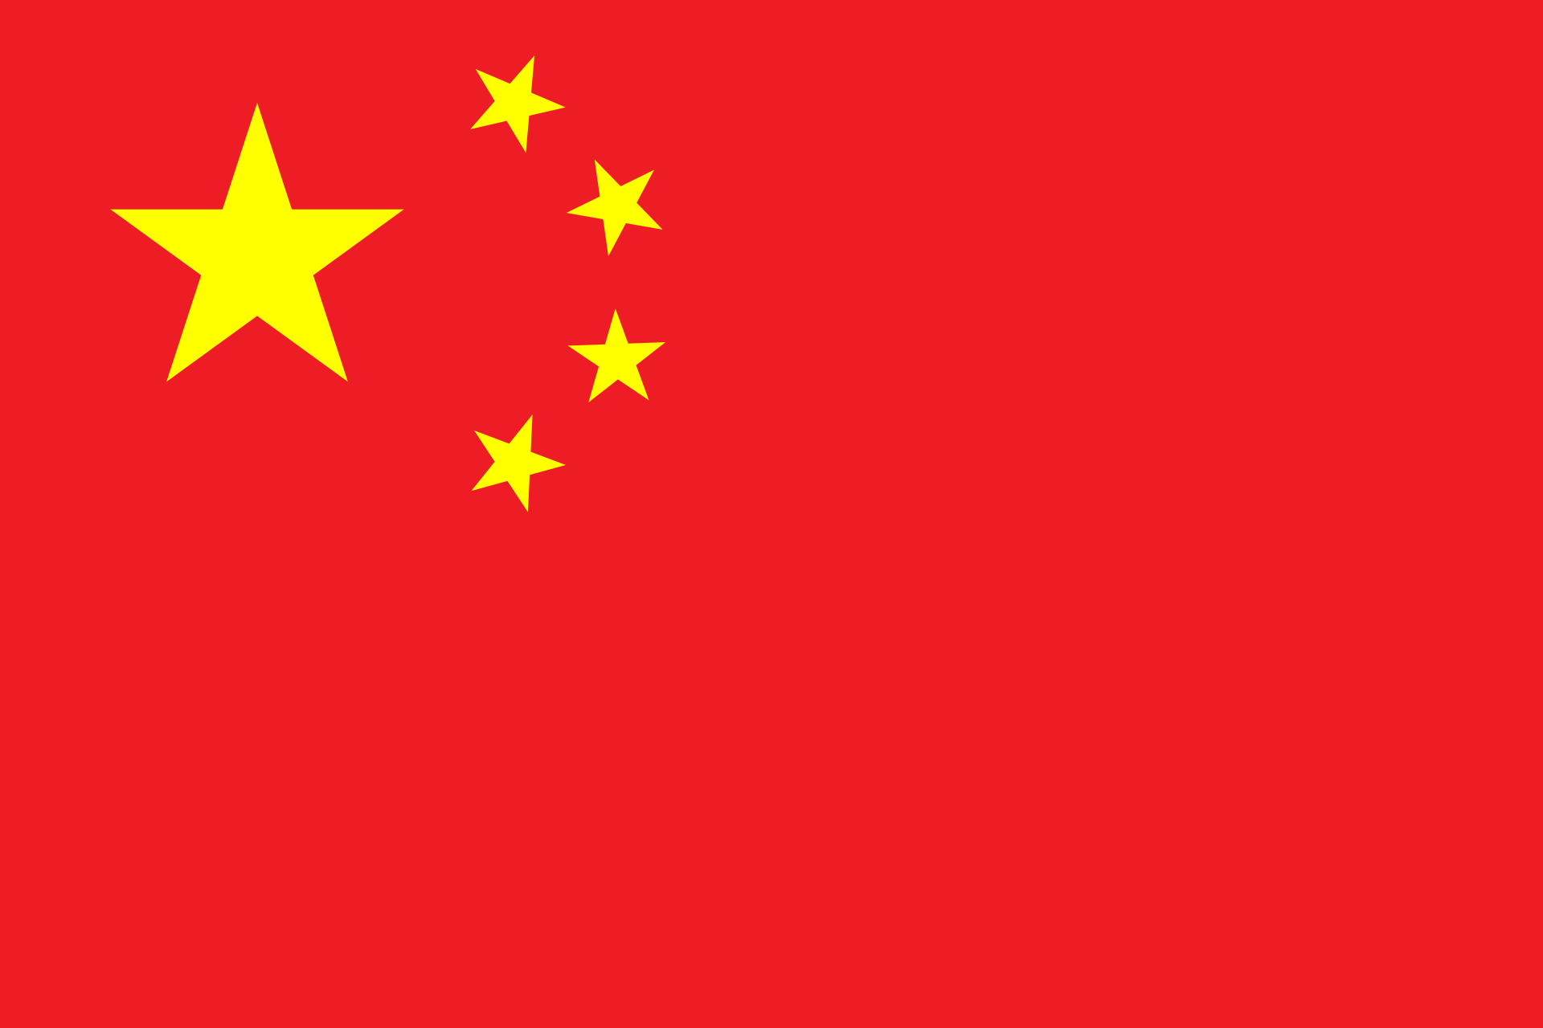
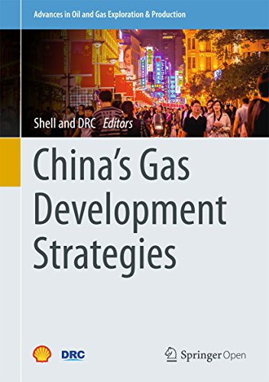
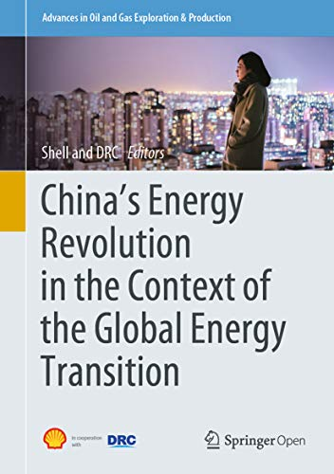
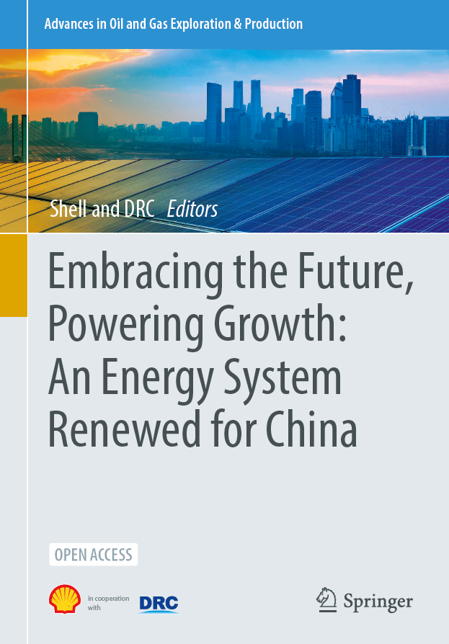
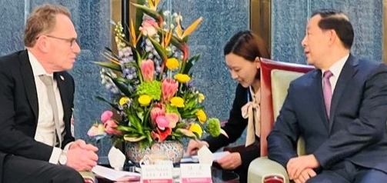
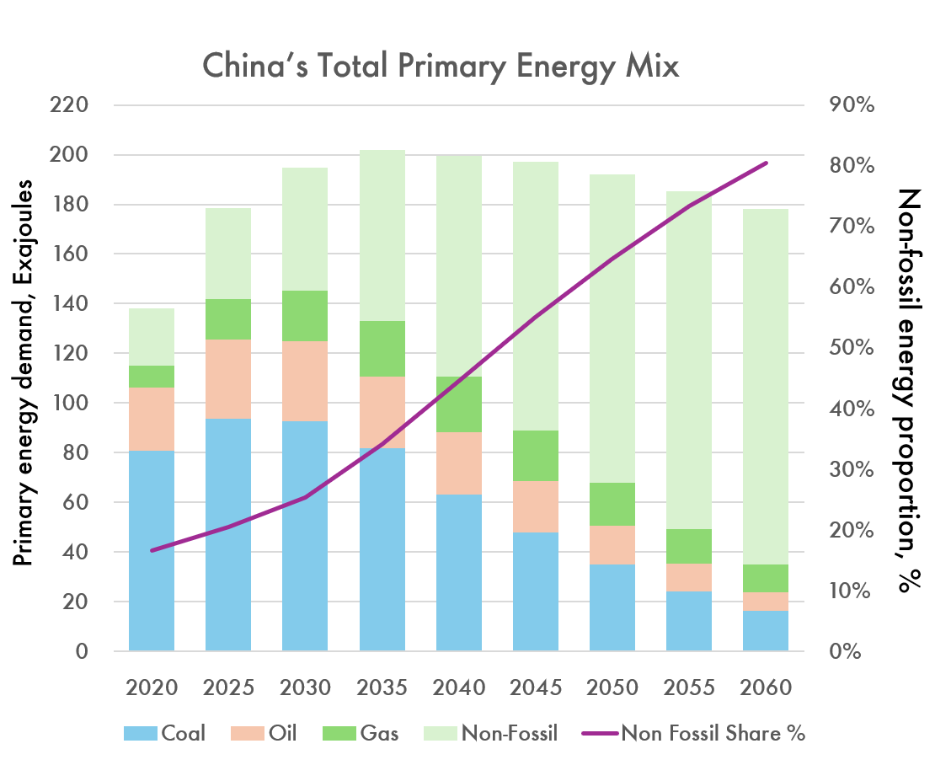
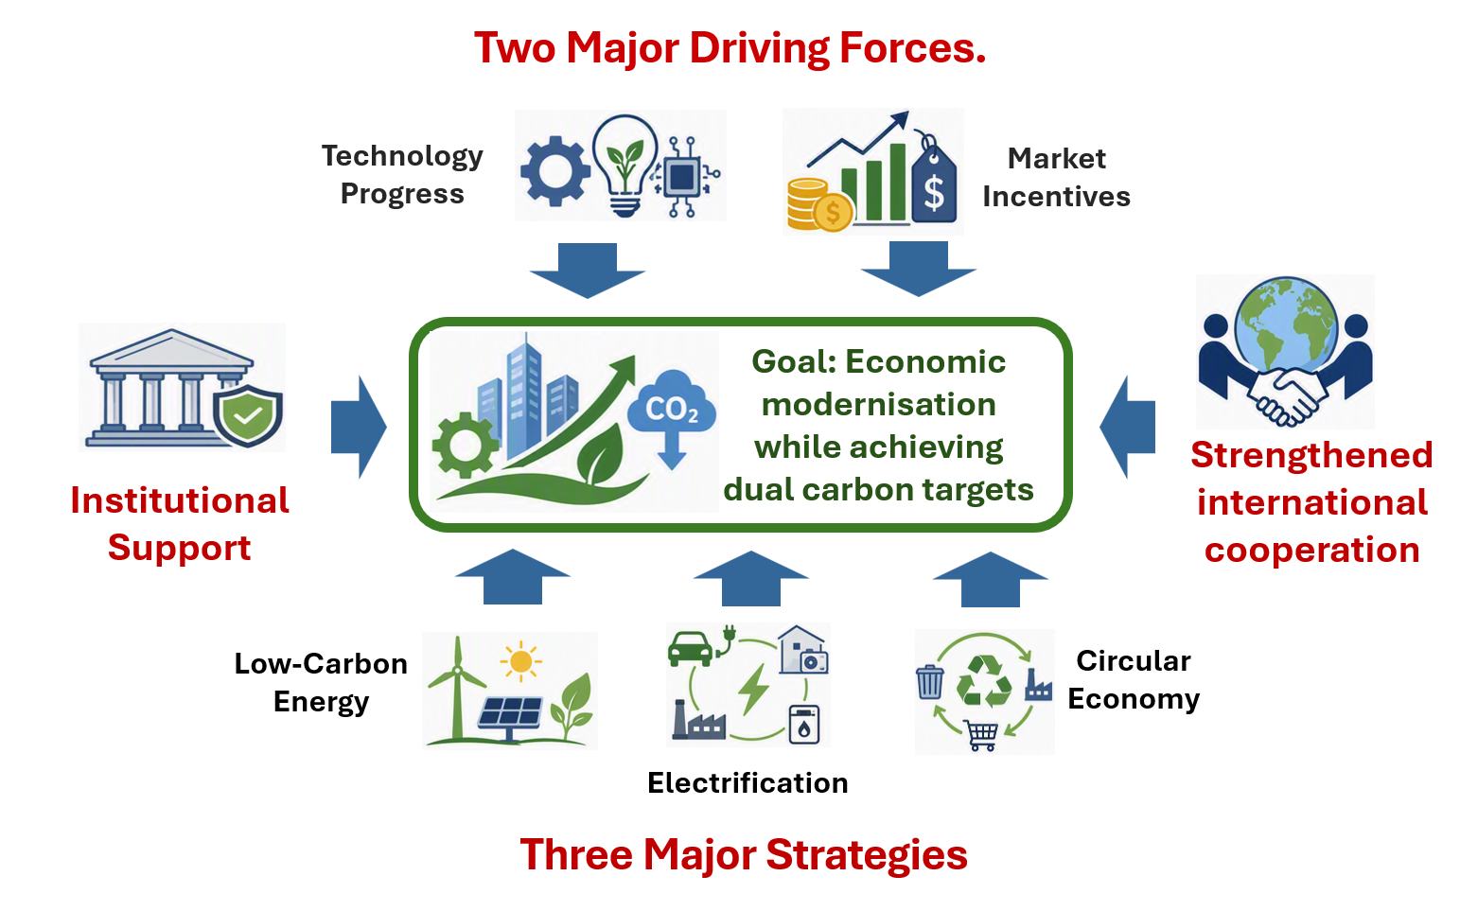
MARKET ENGAGEMENT & EXTERNAL INSIGHTS
Shell – DRC Collaboration
Chinese Government partnership to shape their Energy Transition
SHAPE
CONNECT
ACCELERATE
Mallika Ishwaran, William King
SCA Global Team F2F 2026 | 7–8 September
An unprecedented example of governments and businesses working together for common good
Since 2011, Shell has worked with the Chinese Government’s Development and Research Center (DRC) to shape China’s energy system.
The scope of the studies has developed as China’s energy objectives evolved from supporting economic progress to achieving net zero while sustaining economic development and energy security. The fifth study is nearing completion.
Shell is a trusted strategic policy thinking partner
Shell provides the government with international best practice leading to better policy formulation
Proven, successful, ways of working
Shell brings global energy system experience while DRC has the in depth understanding of China’s economy, energy system, and politics.
A long-term relationship
Shell’s Chairman met Minister Lu Hao in March and agreed a sixth study.
China’s Medium- to Long-Term Energy Development Strategy
Accelerate the low-carbon transformation of energy and build a safe and efficient new energy system
Study 1 Study 2 Study 3 Study 4 Study 5
2011-13 2014-15 2015-18 2019-22 2023-26
Shell and DRC jointly publish the results which are free to download here:
https://www.shell.com/news-and-insights/scenarios/scenarios-where-you-live.html
The current fifth study recognises building a new energy system Is essential for China to modernise its economy while meeting peak emissions by 2030 and Net Zero in 2060
Building the new energy system requires leveraging two key drivers and implementing three major strategies.
Focus is also needed on improving five institutional areas:
strengthen energy market systems;
advance carbon market reform;
promote dual control of emissions;
strengthen energy security;
support a just transition for fossil energy.
Strategic Policy development with Governments is win-win
Informed Policy Development
Global best practice - learning from other countries including impact of different policy approaches.
Extensive energy system expertise.
A better policy environment for Shell
Policy outcomes which provide a more certain and stable policy environment for us to operate in.
Enhanced Strategic Insights
Advantaged business environment insights to shape our strategies.
(not only within in China, but also trading to China, and ventures with Chinese SOEs)
Shape. Connect. Accelerate.
September 7–8, 2026

